Slide 1
HTML TAGS
MCNDHS
Ms. Eng

Slide 2
AIM: HOW DO WE CREATE A LIST IN HTML?
Do now:
Daily Grade: 50%
On-time/attendance/not leaving the classroom: 25%
Cellphones: 25%
Notes:25%
Classwork/Homework: 25%
Friday Assessments: 50%

Slide 3
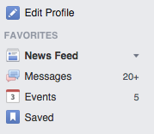
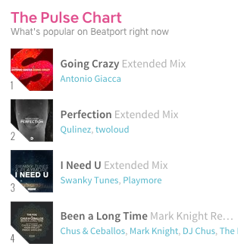
WHERE DO YOU SEE IT?

Slide 4
WHAT CATEGORY DOES THE LIST HTML TAG BELONG IN?
STRUCTURAL
you are essentially creating empty
transparent “slots” where you can add content to it.

Slide 5
ANOTHER PERSPECTIVE

Slide 6
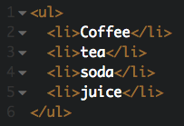

LIST STYLE 1: UNORDERED
Tag: <ul> </ul>
Must include: <li></li> for each entry

Slide 7
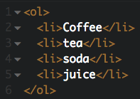
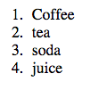
LIST STYLE 2: ORDERED LIST
Tag: <ol> </ol>
Must include: <li></li> for each entry

Slide 8
OTHER LIST STYLES:
We will be learning this technique called adding “ATTRIBUTES” to each of the tags that we learn.
<ul style=“list-style-type: “>
<li></li>
<li></li>
<li></li>
</ul>

Slide 9
WHY DO WE NEED TO APPRECIATE THIS TAG?
The list tag is extremely useful because later on when we are learning how to design, we will need to find groups of html where we can adjust the design.
Adjusting by groups is faster than individually

Slide 10
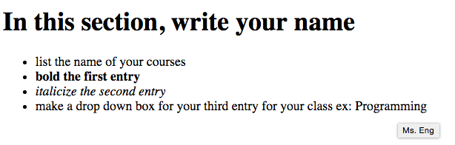
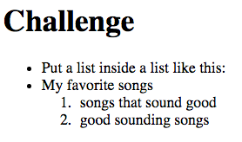
ACTIVITY
extra credit!

